Slide 1

Exploratory data analysis – retail grip December ’21 data science and business analytics Task #2
By : Harshini Marappan

Slide 2
Problem statement
Perform exploratory data analysis on the dataset 'samplesuperstore’ .
As a business manager find out the weak areas where you can work to make more profit .
What all business problems you can derive by exploring the data ?
Create dashboards

Slide 3
Dash boards
Business problems

Slide 4
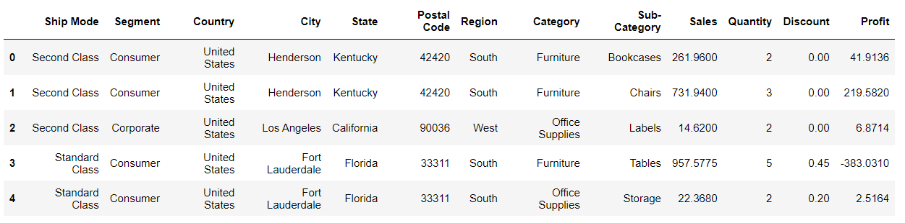
Data set preview

Slide 5

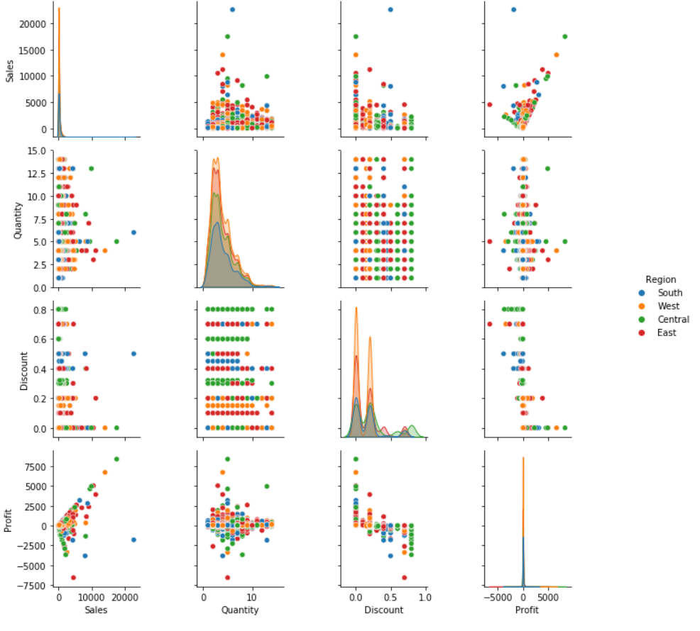


Discounts don’t affect the sales much , but drastically affect profit .
If discount hadn’t been there , profit would have been better.
Would be better if unnecessary discounts are avoided .

Slide 6


Almost no relationship between quantity and profit.
Maybe some products are more expensive than the others. So main contributor of profit is cost.
Low quality, cheap products are kept in stock .
Must focus on product quality and quantity (variety of products and prices, since some customers may not prefer expensive products) .

Slide 7
THESE SUPER STORES FOCUS MORE ON OFFICE RELATED PRODUCTS AND NOT ESSENTIALS :
THESE KIND OF PRODUCTS ARE NOT BOUGHT FREQUENTLY
THAT COULD ALSO BE ONE OF THE REASON FOR LIMITED SALES AND PROFIT
THIS CHAIN OF SUPERSTORES HAS SOLD MORE PRODUCTS TO INDIVIDUAL CUTOMERS RATHER THAN GETTING BULK ORDERS FROM CORPORATES
THIS MAY ALSO BE ONE OF THE REASON FOR LESS PROFIT

Slide 8
SOME REGIONS MAY HAVE FEWER NUMBER OF OUTLETS IN SOME CASES THERE MAY BE ONLY ONE OUTLET :
IF THEIR SERVICE /PRODUCTS ARE NOT UPTO THE MARK , THEN CUSTOMERS ARE COMPELLED TO LOOK FOR ALTERNATIVES.
THEY FACE HIGH COMPETITION FROM OTHER SUPERMARKETS
NEED TO BE VERY CAREFUL IN THEIR SALE STRATEGIES.

Slide 9
THANK YOU !!!!

